Slide 1
Support Vector Machines

Slide 2
Types of Variable
Dependent Variables and Independent Variables
An independent variable, sometimes called an experimental or predictor variable, is a variable that is being manipulated in an experiment in order to observe the effect on a dependent variable, sometimes called an outcome variable

Slide 3
Categorical and Continuous Variables
Categorical variables are also known as discrete or qualitative variables.
Nominal - when there is no natural ordering among the categories
Ordinal - when there is a natural order among the categories, such as, ranking scales or letter grades.
Dichotomous - when there are only two possible levels
Continuous can take on any value between its minimum value and its maximum value

Slide 4
types of Machine Learning Algorithms
Supervised Learning
Unsupervised Learning
Reinforcement Learning:

Slide 5
Supervised Learning
Supervised learning is done using a ground truth
Best approximates the relationship between input and output observable in the data

Slide 6
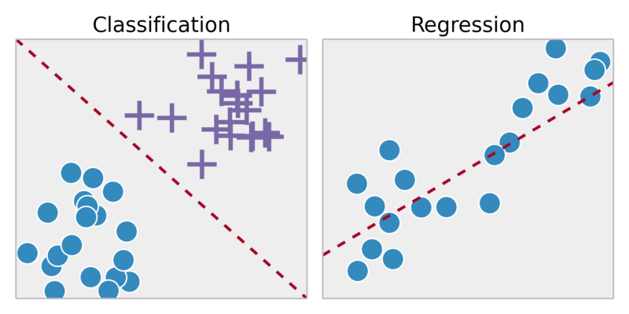
CLASSIFICATION VS REGRESSION

Slide 7
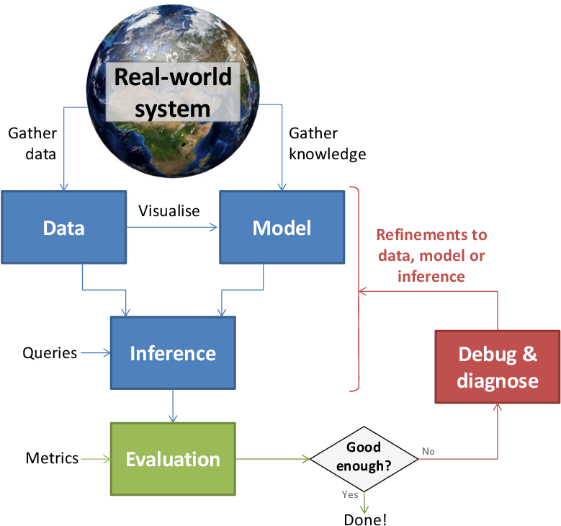
Machine Learning Cycle
Training
Testing
Validation

Slide 8
Multiclass vs Multilabel Problem
Multiclass classification means a classification task with more than two classes; e.g., classify a set of images of fruits which may be oranges, apples, or pears. Multiclass classification makes the assumption that each sample is assigned to one and only one label: a fruit can be either an apple or a pear but not both at the same time.
Multilabel classification assigns to each sample a set of target labels. This can be thought as predicting properties of a data-point that are not mutually exclusive, such as topics that are relevant for a document. A text might be about any of religion, politics, finance or education at the same time or none of these.

Slide 9
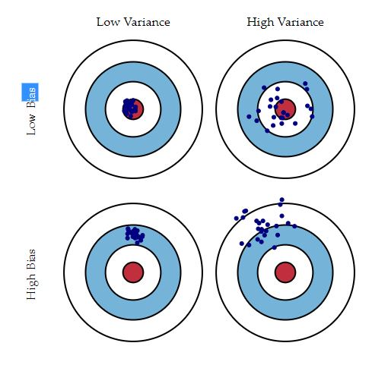
Bias-Variance Trade-Off
The goal of any supervised machine learning algorithm is to achieve low bias and low variance
Parametric or linear machine learning algorithms often have a high bias but a low variance.
Non-parametric or non-linear machine learning algorithms often have a low bias but a high variance

Slide 10
EDA (Exploratory Data Analysis)
Step 1: Understand the problem
Step 2: Understand data
Step 3: Univariate data analysis
Step 4: Multivariate data analysis
Step 5: Dimensionality reduction

Slide 11
Cross-validation for detecting and preventing overfitting
What is Overfitting
What is Cross Validation
y
y
x
x

Slide 12
Features in Machine Learning
Def:
Features are the variables found in the given problem set that can strongly/sufficiently help us build an accurate predictive model
Feature Engineering
The process of using domain knowledge of the data to create features that make machine learning algorithms work.
Feature Selection - put garbage in, you will only get garbage to come out
It enables the machine learning algorithm to train faster.
It reduces the complexity of a model and makes it easier to interpret.
It improves the accuracy of a model if the right subset is chosen.
It reduces overfitting.

Slide 13
Support Vector Machine
1. What is SVM and how does it work?
2. Main Ideas
3. How would you classify this data?
4. An example of small and large margins.
5. Transforming the Data.
6. Learning.
7. Support vectors.
8. Kernel functions.
9.Predicting the classification

Slide 14
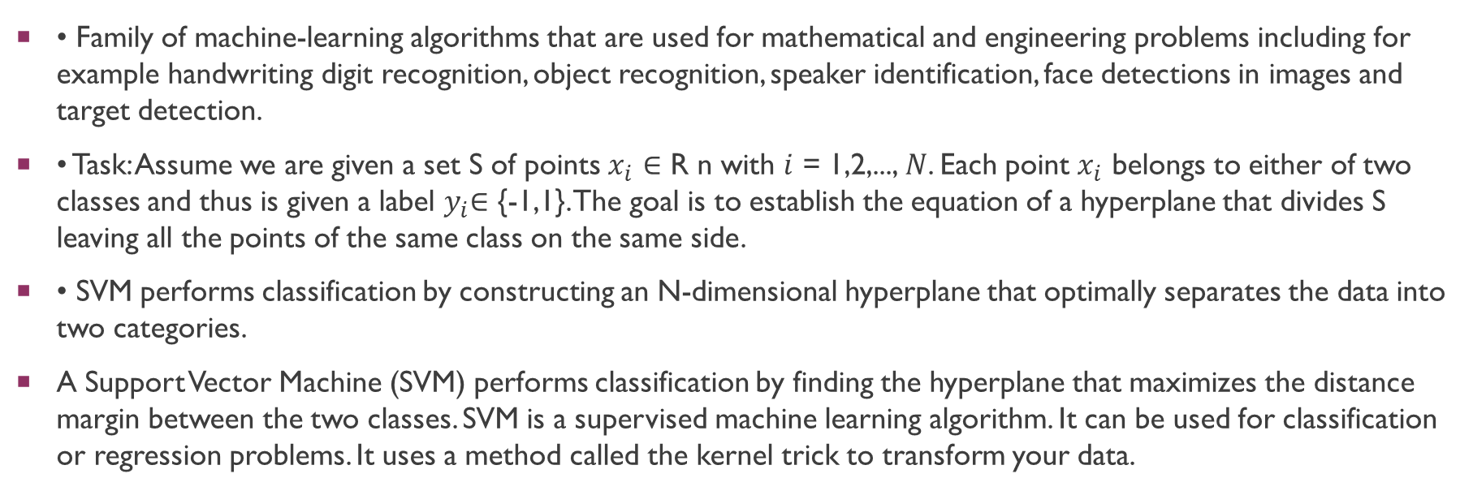
What is SVM and how does it work?
• Family of machine-learning algorithms that are used for mathematical and engineering problems including for example handwriting digit recognition, object recognition, speaker identification, face detections in images and target detection.
• Task: Assume we are given a set S of points $x_{i}$ ∈ R n with $i$ = 1,2,..., $N$. Each point $x_{i}$ belongs to either of two classes and thus is given a label $y_{i}$∈ {-1,1}. The goal is to establish the equation of a hyperplane that divides S leaving all the points of the same class on the same side.
• SVM performs classification by constructing an N-dimensional hyperplane that optimally separates the data into two categories.
A Support Vector Machine (SVM) performs classification by finding the hyperplane that maximizes the distance margin between the two classes. SVM is a supervised machine learning algorithm. It can be used for classification or regression problems. It uses a method called the kernel trick to transform your data.

Slide 15
Main Ideas
Max-Margin Classifier
Formalize notion of the best linear separator
Lagrangian Multipliers
Way to convert a constrained optimization problem to one that is easier to solve
Kernels
Projecting data into higher-dimensional space makes it linearly separable
Complexity
Depends only on the number of training examples, not on dimensionality of the kernel space!

Slide 16
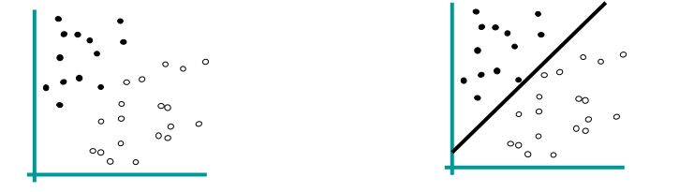
How would you classify this data?
Let’s consider the objects on illustration on the left. We can see that the objects belong to two different classes. The separating line (2 – dimensional hyperplane) on the second picture is a decision plane which divides the objects into two subsets such that in each subset all elements are similar.

Slide 17
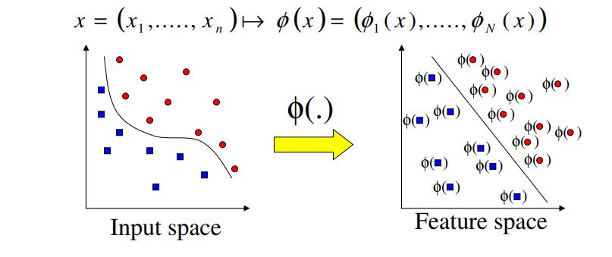
Transforming the Data
The mathematical equation which describes the separating boundary between two classes should be simple. • This is why we map the data of input space into feature space. The mapping (rearranging) involves increasing dimension of the feature space. • The data points are mapped from the input space to a new feature space before they are used for training or for classification. • After transforming the Data and after learning we look for an answer by examine simpler feature space.

Slide 18

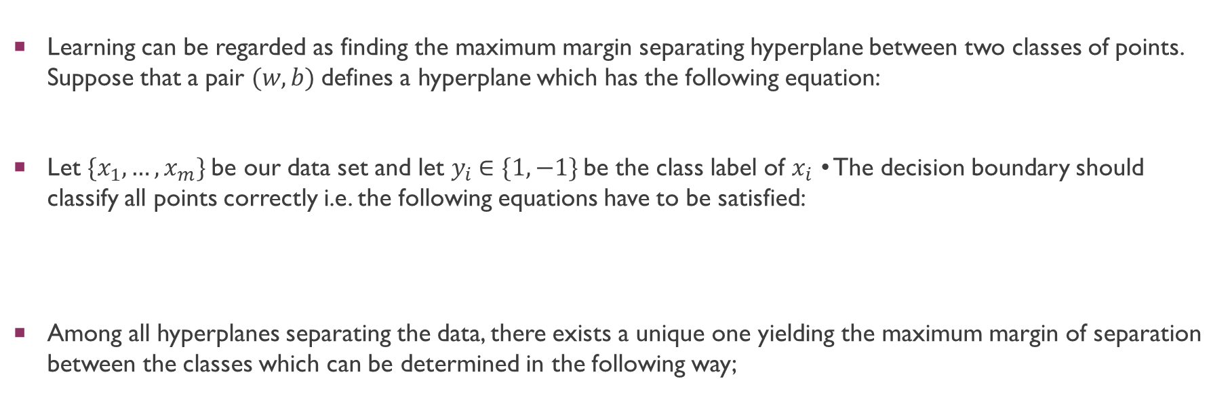
Learning
Learning can be regarded as finding the maximum margin separating hyperplane between two classes of points. Suppose that a pair $(w,b)$defines a hyperplane which has the following equation:
Let $\{x_{1}, …, x_{m}\}$be our data set and let $y_{i}$∈ $\{1,−1\}$be the class label of $x_{i}$ • The decision boundary should classify all points correctly i.e. the following equations have to be satisfied:
Among all hyperplanes separating the data, there exists a unique one yielding the maximum margin of separation between the classes which can be determined in the following way;

Slide 19
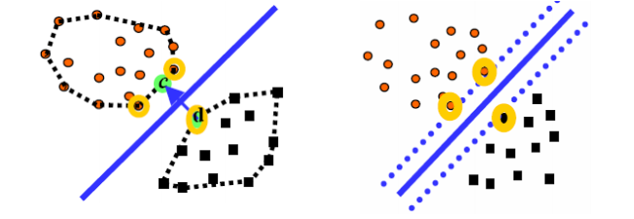
Support Vectors
Let’s notice that not all of the training points are important when choosing the hyperplane. To make it clear let’s consider the following example:
Let’s make two convex hulls for the two separate classes of points. It’s is clear that the rear points are not important for choosing the decision boundary. At the above pictures the points which are relevant are marked by yellow color. The points are called Support Vectors

Slide 20
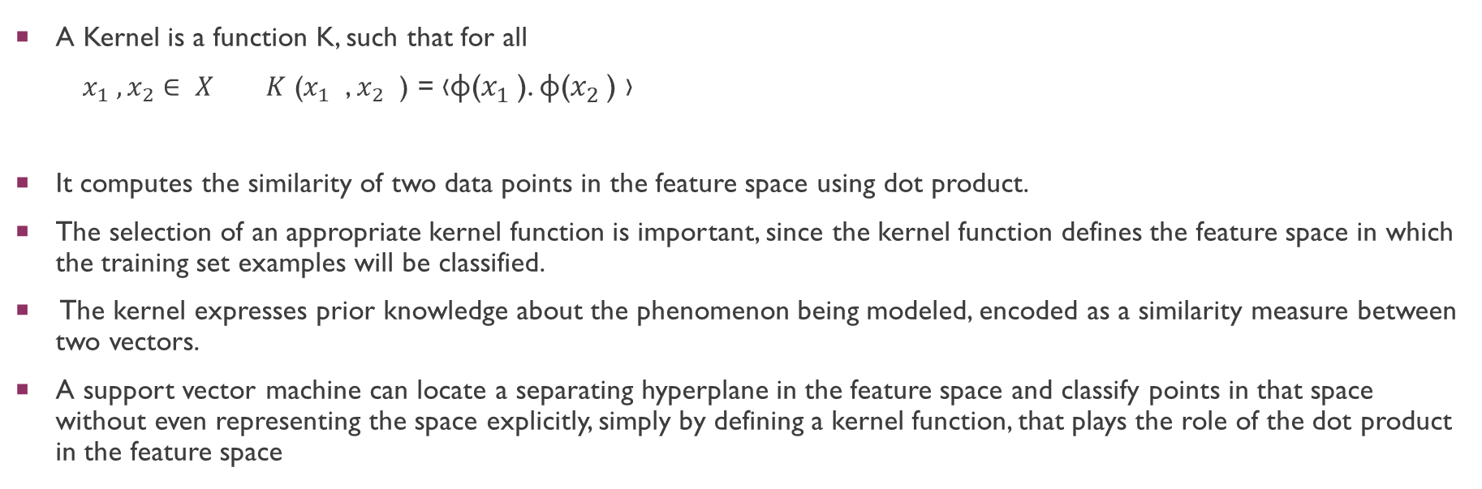
Kernel functions
A Kernel is a function K, such that for all
$x_{1} ,x_{2}∈ X K$ ($x_{1}$ , $x_{2}$ ) = ‹φ($x_{1}$). φ($x_{2}$) ›
It computes the similarity of two data points in the feature space using dot product.
The selection of an appropriate kernel function is important, since the kernel function defines the feature space in which the training set examples will be classified.
The kernel expresses prior knowledge about the phenomenon being modeled, encoded as a similarity measure between two vectors.
A support vector machine can locate a separating hyperplane in the feature space and classify points in that space without even representing the space explicitly, simply by defining a kernel function, that plays the role of the dot product in the feature space

Slide 21

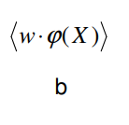
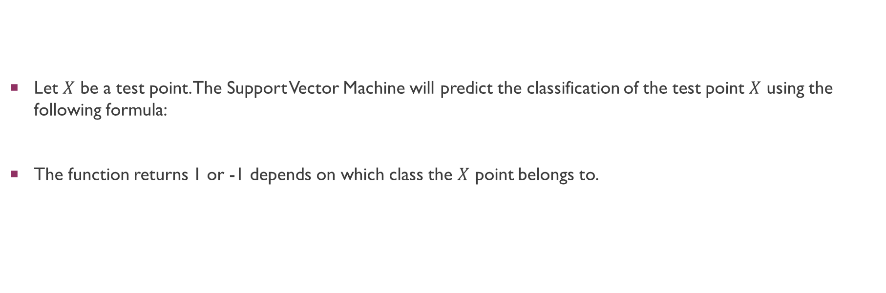
Predicting the classification
Let $X$ be a test point. The Support Vector Machine will predict the classification of the test point $X$ using the following formula:
The function returns 1 or -1 depends on which class the $X$ point belongs to.
this is a dot product of vector w and vector form the origin to the point
- this is a shift of the hyperplane from the origin of the coordinate system.

Slide 22
Non-linear SVMs
Datasets that are linearly separable with some noise work out great:
But what are we going to do if the dataset is just too hard?
How about… mapping data to a higher-dimensional space:
0
x
0
x
x²
0
x

Slide 23
Difficulties To Train SVM
Choice of kernel
- Gaussian or polynomial kernel is default
- if ineffective, more elaborate kernels are needed
- domain experts can give assistance in formulating appropriate similarity measures
Choice of kernel parameters
- e.g. σ in Gaussian kernel
- σ is the distance between closest points with different classifications
- In the absence of reliable criteria, applications rely on the use of a validation set or cross-validation to set such parameters.
Optimization criterion –
- Hard margin vs Soft margin
- a lengthy series of experiments in which various parameters are tested

Slide 24
Regression vs Classification in SKLEarn
SVM - Classification SVR - Regression / Prediction

Slide 25
Code – SVM training using SKLearn
Notebook Link

Slide 26
Pipeline
Sequentially apply a list of transforms and a final estimator
The purpose of the pipeline is to assemble several steps that can be cross-validated together while setting different parameters
How to use Pipeline in SKLEARN

Slide 27
Code – Svm training by pipeline
Notebook Link

